Slide 1
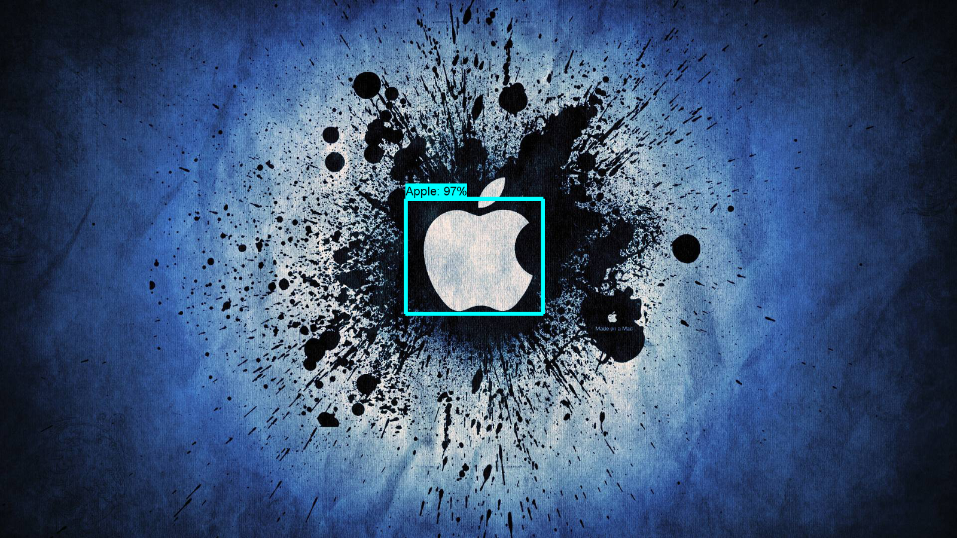
KRIYA – Phase I
ISO Symbols Detection on Shipper Labels

Slide 2

Business Problem
How
Business Problem
Business Problem
Business Problem
1
Detecting and Recognizing ISO symbols on shipper labels
Apply Object Detection Model to solve this:
OBJECT DETECTION MODEL
Shipper Label with detected symbols
Shipper Label
Annotation CSV

Slide 3
Business Problem
How
Business Problem
Business Problem
Business Problem
ISO Symbols
Accuracy
79%
ISO Symbols
ISO Symbol
70%
8079 Opportunities
Training
70x70
ISO Symbol
30%
Random Background Images
3418
Opportunities
Testing
Random Background Images
1000x600
Random Background Image
Prediction Modeling
1000x600
1000x600

